Slide 1
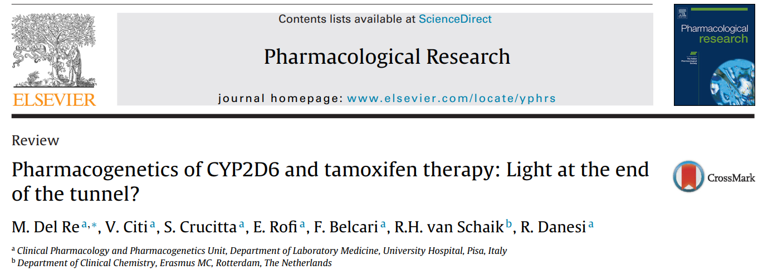
서울아산병원 Subintern
임상약리학과
신영하

Slide 2
Contents
Introduction
Tamoxifen metabolism
CYP2D6
Drug-drug interactions
Tamoxifen transport(OATP) and inactivation (UGT)
Available clinical guidelines
Conclusions

Slide 3
Introduction

Slide 4
Tamoxifen
Selective estrogen receptor modulator(SERM)
Most commonly used drug for ER+ breast cancer patients(~60%)
Standard of care for at least 5 years
Benefits and Adverse drug reactions(ADR) vary
1/3 relapse within 15 years
Early breast cancer patients with 5 years tamoxifen after surgery
tamoxifen and its metabolites(endoxifen) levels differ between individuals
In steady state

Slide 5
Linked to metabolism
Prodrug metabolized mainly via cytochrome P450 (CYP) enzymes
into multitude of active metabolites with variable potencies towards the ER
Drug–drug interactions effect plasma conc. of endoxifen
SSRIs for hot flashes in women who take tamoxifen
some SSRIs (i.e. paroxetine, fluoxetine) inhibit CYP2D6
negative affect metabolic activation of tamoxifen
Good understanding of these interactions are important

Slide 6
Tamoxifen metabolism

Slide 7
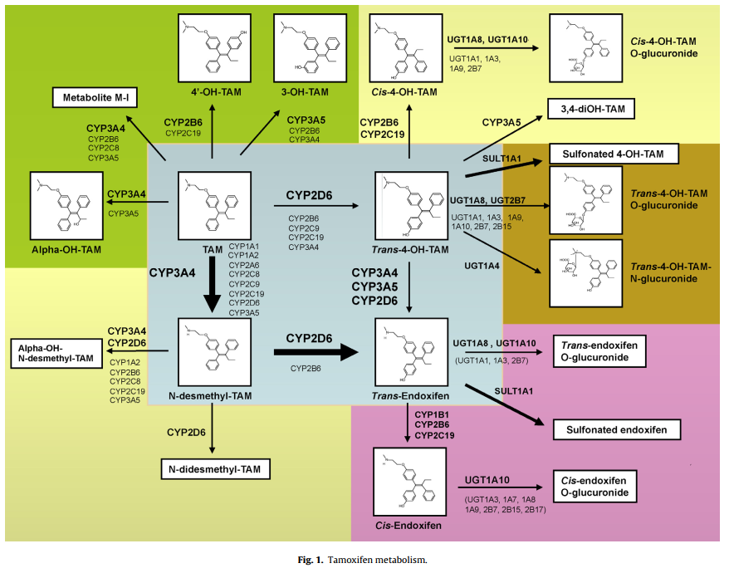
Tam → N-desmethyl-Tam
By CYP3A4/5
~90%
Tam → 4-OH-Tam
Minor
By CYP2D6
→ endoxifen
From N-desmethylTam and 4-OH-Tam
By CYP3A4/5 and CYP2D6
High anti-estrogenic potential
4-OH-Tam and endoxifen
similar potency
=lower N-desmethylTam/endoxifen ratio
4-OH-Ndesmethyl-tamoxifen=endoxifen
Tamoxifen = Tam

Slide 8
Tam → Glucuronide metabolites → Tamoxifen N-oxide
Minor
UGT -> flavin-containing monooxygenases (FMOs)
Inactivated
N-desmethyl-Tam, 4-OH-Tam
UGT
4-OH-Tam
SULT1A1

Slide 9
Endoxifen → Norendoxifen
By CYP3A4/5
potent inhibitor of CYP19A1, which is inactivated by UGTs
trans-4-OH-Tam → cis-4-OH-Tam
CYP1B1, CYP2B6 and CYP2C19
Weakly estrogenic
Possibly associated with drug-resistant phenotyes

Slide 10
CYP2D6

Slide 11
∼2–3% of total liver CYPs
Metabolises ∼15–25% of all clinically used drugs
ie) anti-cancer drugs, antidepressants, antiarrhythmics, antipsychotics
in comparison to relatively minor expression in liver
Enzymatic activity
Genetic polymorphisms
Highly variant (105 allelic variants)
hepatic protein content varies dramatically among people
inhibited by numerous compounds that bind it with high affinity or that are competing for the enzyme

Slide 12
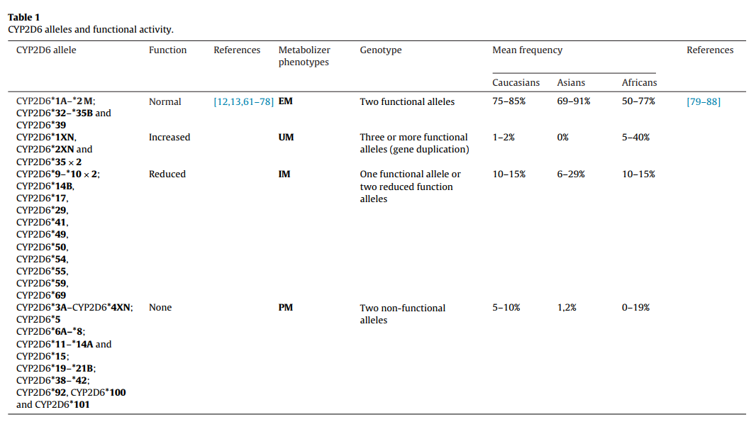

Slide 13
splice-site disrupting SNP c.1846G>A
m/c inactivating variant among Caucasians (18%-20%)
CYP2D6*10
m/c decreased activity allele among the Asian population(>50%)
c.100C>T SNP abolishes the PPGP sequence necessary for folding of P450, thus reducing its affinity for substrates
CYP2D6*17
major deficient variant allele among the African American population
encoding for an altered active site structure, leading to an altered substrate specificity

Slide 14
Based on genotypes, four groups by functional activity
poor metabolizers = PM
two non-functional CYP2D6 alleles
intermediate metabolizers = IM
one functional allele or two reduced function alleles)
extensive (/normal) metabolizers = EM
two functional alleles
ultra-rapid metabolizers = UM
duplication of functional alleles
PMs and IMs
60% and 74% lower endoxifen concentrations compared to EM
benefit less from treatment with tamoxifen

Slide 15
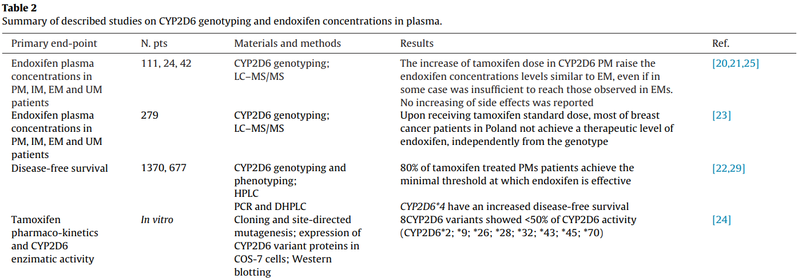
Efficacy of tamoxifen therapy ← endoxifen-threshold plasma level
26% diff. between both ends of quintiles, lower value threshold: 5.97 ng/ml
PM : Tamoxifen dose↑ → Endoxifen conc.↑ (no diff. in side effects)
CYP2D6 inhibitors → below threshold regardless of genotype
[22]Madlensky et al

Slide 16
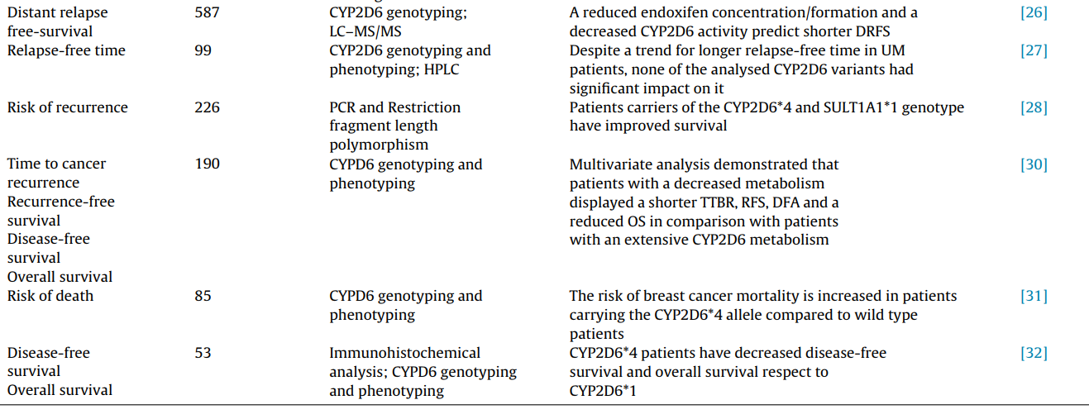
DRFS↑ : N-desmethylTam/endoxifen ratio↓ and CYP2D6 activity score↑
RFT↑ if EM or UM (p = 0.19), not associated with other CYPs(2C9, 2C19, 2D6, and 2B6)
2D6*4 : debatable.
DFRS : distant relapse-free survival
RFT : relapse-free time
Notes:
he length of time after primary treatment for a cancer ends that the patient survives without any signs or symptoms of that cancer

Slide 17
Drug-drug interactions

Slide 18
If and how the CYP2D6-inhibitors influence the tamoxifen outcome.
Hot flashes
~80% of tamoxifen-treated women suffer
Major reason for co-prescription of other drugs
Standard treatment : HRT with estradiol or progestational agents
recent data suggest SNRI effective as non hormonal treatment
SNRI : serotonin reuptake and norepinephrine reuptake inhibitors

Slide 19
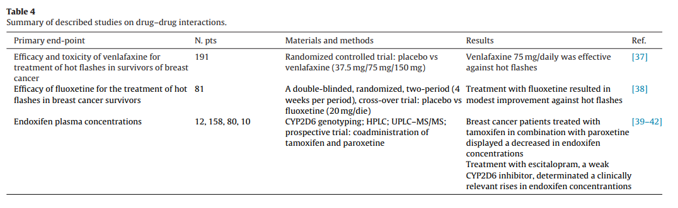
Venlafaxine : dose dependent effect : 27%, 37%, 61%, and 61%
balanced against the drug’s side-effects
Fluoxetine : 50% vs 36%
Paroxetine effect on endoxifen plasma conc.
Mean endoxifen plasma conc. in CYP2D6 EM (Borges et al.[40])
potent CYP2D6 inhibitors << non-takers
(23.5 ± 9.5 nmol/L vs 84.1 ± 39.4 nmol/L, p < 0.001)

Slide 20
Some prescribed SSRIs classified as strong CYP2D6 inhibitors
can affect CYP2D6 activity and endoxifen levels
compromising tamoxifen efficacy.
UM phenotype
mainly due to genetic factors rather than drug interactions.
few drugs known to induce CYP2D6 (i.e., dexamethasone and rifampicin)

Slide 21
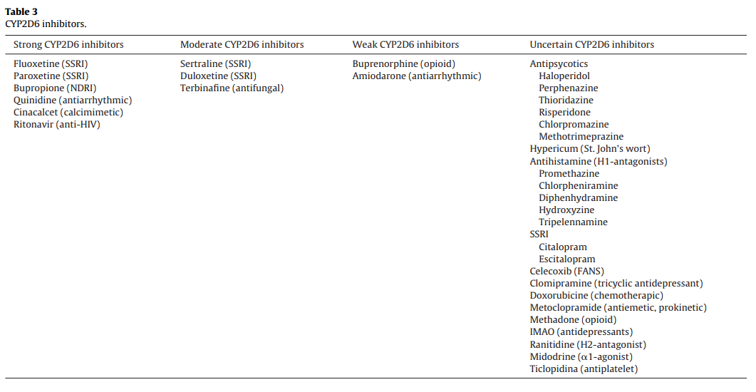

Slide 22
Venlafaxine (weak) > Paroxetine (strong) for Tam Adjuvant therapy ?
24 EM patients taking CYP2D6 inhibitors
mean plasma endoxifen concentration 58% lower (38.6 nM vs 91.4 nM)
plasma endoxifen conc. reduced substantially in paroxetine and less in venlafaxine.
Similar on escitalopram(weak)

Slide 23
Co-prescription of strong CYP2D6 inhibitors decreased over time and increased for weak CYP2D6 inhibitors.
A Belgian analysis
evolution of co-prescriptions of tamoxifen and CYP2D6 inhibitors
Belgium women with at least one tamoxifen registration
Jan.2006~ Dec.2009
During the period, co-prescription of fluoxetine and paroxetine decreased, while co-prescription of venlafaxine increased over time as well
Difference of knowledge in medical practitioners
Major prescribers : General practitioners, followed by psychiatrists, internists (including oncologists), and gynaecologists
Gynaecologists and psychiatrists prescribed more venlafaxine and less paroxetine than general practitioners and internists

Slide 24
Tamoxifen transport (OATP) and inactivation (UGT)

Slide 25
OATP : organic anion-transporting polypeptide
OATP1B1
encoded by SLCO1B1 gene
one of the main hepatic transmembrane transporter protein
highly expressed in the sinusoidal membrane of human hepatocytes.
Highly polymorphic transporter
M/C : c.521T > C (rs4149056) and c.388A > G (rs2306283) polymorphisms
OATP1B1 c.521C allele associated with decreased OATP1B1 transport activities

Slide 26
Wlcek et al. in 2008[46]
in vitro detection of OATP1B1 expression in breast cancer cell lines and normal breast tissue samples
OATP2B1, OPATP3A1 and OATP4A1 : non-malignant > tumor tissue
OATP genes play a role in drug therapy?
few studies available on association of OATP1B1 polymorphisms with treatment response and/or patient OS for breast cancer patients treated with tamoxifen.
Muto et al. [47]
expression of OATP8/SLCO1B3 in 102 cases of breast Ca. using IHC
OATP8/SLCO1B3 immunoreactivity
Reduced breast cancer recurrence
Improved patient’s prognosis

Slide 27
Justenhoven et al., 2011 [48]
potential functions of 31 polymorphisms of OATPs and pregnane X receptor in breast cancer risk
no associations
Zhang et al.[49]
association of polymorphisms on paraffin blocks obtained from surgery
CYP2D6*10 (c.100C > T and c.1039C > T), OATP1B1 c.388A > G and c.521T > C,
OS in 296 HR+ breast cancer patients after adjuvant tamoxifen therapy
significant difference in OS
OATP1B1 wild-type and the mutant genotype carriers the C allele
OATP1B1 c.521T > C polymorphism may be an independent prognostic marker for breast cancer patients using tamoxifen therapy

Slide 28
SULT1A and UGT also play a role in the tamoxifen metabolism and transport
Fernández-Santander, 2013[50]
relationship between concentrations of tamoxifen metabolites and genotypes
CYP2D6, CYP3A4, CYP3A5, SULT1A1, SULT1A2 and SULT1E1
135 patients with ER+ breast cancer
possible role for SULT1A2 in maintaining optimal plasma concentrations
SULT1A2*2 and SULT1A2*3 alleles had higher plasma levels of 4-OH-Tam
Romero-Lorca et al., 2015[51]
correlations between the plasma concentrations of tamoxifen’s glucuronide metabolites and genotypes
UGT1A4 (p.Pro24Thr), UGT1A4 (p.Leu48Val), UGT2B7(p.His268Tyr), UGT2B15 (p.Asp85YTyr), UGT2B15 (p.Lys523Thr) and UGT2B17del
132 patients with ER+ breast cancer under tamoxifen treatment
Candidates for tamoxifen therapy
by eliciting effective plasma active tamoxifen metabolite levels
UGT1A4 48Val, UGT2B7 268Tyr or with wild type genotypes for UGT2B17 del and UGT2B15 523Lys

Slide 29
Available clinical guidelines

Slide 30
National Comprehensive Cancer Network
The Committee of the American Society of Clinical Oncology
many research efforts
CYP2D6 genotyping should be introduced in clinical practice
whether patients with low activity CYP2D6 genotypes receive less benefit from tamoxifen treatment
results of these studies are controversial
and CYP2D6 genotyping is not recommended
Apparently, there is a request, presumably also patient driven, for CYP2D6 testing for tamoxifen since this test is offered by a number of laboratories in US and Europe.

Slide 31
NCCN : National Comprehensive Cancer Network
ASCO : The Committee of the American Society of Clinical Oncology
Institutions | Recommendations
FDA | “tamoxifen is a substrate of CYP3A4 and 3A5, 2C9 and 2D6, but does not recommend a pharmacogenetics test for CYP2D6”
NCCN | not recommend CYP2D6 genotype testing to personalize endocrine therapy (limited and conflicting evidences coming from 2 major published studies (BIG 1–98 and ATAC trial)) *criticized for the produced results (o.a. Ratain CPT 2014, Brauch JCO)
ASCO | Encourage caution with concurrent use of CYP2D6 inhibitors because of drug–drug interactions Find available data on CYP2D6 pharmacogenetics insufficient to recommend testing as a tool to determine an adjuvant endocrine strategy
Dutch Pharmacogenetics Working Group | Suggest aromatase inhibitor for PM and IM patients Or if CYP2D6 genotype unknown, avoid concomitant use of CYP2D6 inhibitors in IM pts.

Slide 32
Clinical importance CYP2D6 genotyping to outcome
still unclear and contradictory
due to differences across studies in data collection, analysis and interpretation.
difference in the genotyping procedure between trials
somatic DNA
frequently show “loss of heterozygosity”
may differ from germinal DNA.
i.e.) ATAC and BIG 1–98 trials on intense criticism
CYP2D6 genotyping performed on DNA from paraffin-embedded cancer tissue instead of blood-or buccal-derived germinal DNA.
reported substantial genotyping errors
Chromosomal instability → genotyping errors ?
misclassification of IM to EM, confounding research results .

Slide 33
Conclusion
Relevant role of tamoxifen metabolism in drug efficacy
low endoxifen levels following standard dose tamoxifen in many studies is the only independent predictor factor of therapy failure.

Slide 34
Conclusions

Slide 35
Personalization of treatment requires a patient specific approach
Factors that affect drug efficacy
including genetic and non-genetic elements with respect to CYP2D6.
Genotyping
Direct endoxifen measurements or administration of endoxifen
instead of tamoxifen
Drug interaction on the CYP2D6 pathway
Though complex, physician should consider drug effects
based on major cohort studies, consult laboratory specialist

Slide 36
감사합니다.

Slide 37
CYP2D6 studies

Slide 38
Martinez de Duenas ˜ et al. [20]
Dose adjustment for CYP2D6 PM, compared with EM
CYP2D6 genotype and endoxifen concentration from 249 breast cancer patients in adj. treatment with tamoxifen
20 mg tamoxifen standard dose :
baseline endoxifen conc. : EM patients (11.30 ng/ml) > PM patients (2.33 ng/ml).
PM patients tamoxifen dose escalation : 40 mg and to 60 mg daily for a 4-month period each
tamoxifen dose increase in PM significantly raised the endoxifen concentration to 8.38 ng/ml and to 9.30 ng/ml, respectively
authors say tamoxifen doses of 40 mg and 60 mg were generally well tolerated and did not observe any differences in the incidence of ADRs after increasing the tamoxifen dose

Slide 39
prospective study[21]
early breast cancer patients using tamoxifen
selected 12 CYP2D6 PM and 12 IM
included them in a one-step tamoxifen dose escalation for 2 months.
Endoxifen plasma levels and tamoxifen adverse events were determined at baseline and after 2 months.
IM (baseline endoxifen: 17.8 nM) dose escalation with 46 mg increased endoxifen to levels comparable with those observed in extensive metabolizers (IM: 30.3 nM vs EM: 33.7 nM).
PM (baseline endoxifen: 8.0 nM) the mean endoxifen level increased from 24 to 81% of the mean concentration in extensive metabolizers, after 90 mg tamoxifen dose escalation (PM: 27.3 nM vs EM: 33.7 nM).
tamoxifen dose escalation significantly increased endoxifen concentrations without increasing side effects

Slide 40
recent publication[25]
evaluated the effect of tamoxifen dose increment in patients with impaired CYP2D6 activity
raising the tamoxifen dose to 40 mg significantly increased endoxifen concentrations in IMs and PMs
without increasing side effects
patients treated with tamoxifen 20 mg once daily for at least 4 weeks and were classified as PM, IM, or EM based on their genotype and considering their co-medication.
In PM and IM patients, the tamoxifen dose was increased to 40 mg daily for 4 weeks.
Tamoxifen and its metabolites serum concentrations were measured at baseline and 4 weeks after the dose increment.
median baseline endoxifen concentration was different between the three phenotype subgroups
PMs mean of 4.0 mcg/L endoxifen levels, IMs had 8.3 mcg/L, EMs had 11.4 mcg/L (p = 0.040)
increase in tamoxifen dose significantly increased the median endoxifen concentrations
in 4 out of 7 PMs from 3.8 to 7.8 mcg/L (p = 0.001)
in 12 out of 16 IMs from 9.5 to 17.4 mcg/L (p < 0.001), without increasing side effects

Slide 41
Efficacy of tamoxifen therapy depends on an endoxifen-threshold plasma level.[22]
Madlensky et al. [22]
identified an endoxifen-threshold (lower value threshold: 5.97 ng/ml)
recurrence rate : women in upper four quintiles of endoxifen had a 26% lower than women in the bottom quintile
Identify patients who are unlikely to reach clinically sufficient endoxifen plasma levels to better personalize the therapy
Hennig et al.[23]
279 breast cancer patients treated with the standard daily dose of 20 mg of tamoxifen
plasma concentration of five metabolites was significantly correlated with CYP2D6 genotype.
≈60% of patients, endoxifen plasma levels were below 5.97 ng/ml, including the 30% of patients with CYP2D6 EM phenotype.
Due to concomitant use of drugs that can affect CYP2D6 activity, also in EM patients (i.e. SSRIs, expecially paroxetine, strong CYP2D6 inhibitor)
tamoxifen treated patients
the use of strong CYP2D6 inhibitors should be avoided
recommending to perform a direct monitoring of endoxifen plasma concentration to personalize and optimize the treatment

Slide 42
Role of major CYP2D6 allelic variants
Muroi et al. [24]
in vitro functional characterization of 50 CYP2D6 variants.
kinetic parameters and intrinsic clearance of N-desmethyltamoxifen.
50 expression constructs, which were transfected into the COS-7 cell line;
PK only for 20 CYP2D6 variants
because production of other 30 metabolite below detection limit

Slide 43
Genotyping approach to optimize treatment outcome on debate
Saladores et al. [26]
genotype-pharmacokinetic combined analysis in 587 premenopausal patients and clinical outcome evaluation in 306 patients.
Germ-line analysis involved CYP3A5, CYP2C9, CYP2C19 and CYP2D6
Improved distant relapse-free survival (DRFS) was associated with the decreasing of N-desmethyltamoxifen/endoxifen ratio and the increasing of CYP2D6 activity score
Low (<14 nM) endoxifen concentrations compared with high (>35 nM) were associated with shorter DRFS, indicating an association of tamoxifen outcome with endoxifen formation/concentrations

Slide 44
Mwinyi et al. [27]
impact of polymorphisms CYP2D6, CYP2C19, CYP2C9 and CYP2B6 on the relapse-free time (RFT)
99 patients who had undergone adjuvant tamoxifen therapy.
genotyping analysis
comprised CYP2C9*2 and *3, CYP2C19*2, *3, *4, *6 and *17, CYP2B6*6, *7 and *16, CYP2D6*3, *4, *5, *6, *10 and *41
CYP2D6 gene duplications/amplications.
no significant associations between CYP2C9, CYP2C19 and CYP2B6 genotypes and RFT
while a trend toward a lower relapse rate observed for individuals carrying allelic combinations that induce an EM or UM genotype of CYP2D6 (p = 0.19)
concluding that CYP2D6 genotyping has a good predictive value for its activity-scvore, but common variants in CYP2C9, CYP2C19, CYP2D6, and CYP2B6 do not have a significant impact on RFT

Slide 45
2005 and 2007 two published studies [28,29]
226 and 677 breast cancer patients reported a decreased risk of recurrence and a significantly better disease-free survival in patients carriers of the CYP2D6*4 allele.
Even if these findings remain of difficult interpretation, these studies support the effectiveness of tamoxifen in intermediate and poor metabolizers patients.
However, there are no other studies confirming that kind of favorable impact of the *4 allele. [30-32]
A recent meta-analysis[33]
significant association between CYP2D6 genotype and decreased efficacy of tamoxifen for post menopausal estrogen positive women on 20 mg/tamoxifen (HR 1.25)
also clarified very difficult to compare different studies.
New and better designed studies should be done to fully uncover the potential use of CYP2D6 genotyping[34]

Slide 46
Drug-drug interaction studies

Slide 47
In a double-blind, placebo-controlled, randomized trial [37]
efficacy of venlafaxine was assessed in women assigned
placebo(n = 56) or venlafaxine 37.5 mg daily (n = 56), 75 mg daily (n = 55), or 150 mg daily (n = 54).
primary endpoint : average daily hot-flash activity.
After week 4, median hot flash scores were reduced from baseline by 27%, 37%, 61%, and 61%, respectively in the four groups
efficacy must be balanced against the drug’s side-effects
Loprinzi et al. [38]
double-blinded, randomized, two-period(4 weeks per period), cross-over trial
efficacy of fluoxetine (20 mg/d) for treating hot flashes.
primary end-point : hot flashes frequency and hot flash score.
81 randomized women started the protocol therapy
hot flash scores decreased 50% in the fluoxetine arm versus 36% in the placebo arm
concluding that fluoxetine resulted in an improvement of hot flashes

Slide 48
prospective clinical trial[39]
effects of coadministration of paroxetine on tamoxifen metabolism
Measuring tamoxifen and its metabolites in plasma
12 women taking adjuvant tamoxifen
CYP2D6 genotype known and tamoxifen metabolites were measured before and after 4 weeks of coadministered paroxetine
Plasma levels of endoxifen significantly decreased from a mean of 12.4 ng/ml to 5.5 ng/ml
coadministration of paroxetine decreased the concentration of endoxifen in plasma
Borges et al.[40]
evaluated the effect of CYP2D6 genotype and concomitant medications on endoxifen plasma concentrations.
prospectively enrolled 158 patients with breast cancer who were taking tamoxifen
genotyping analyses, measured plasma concentrations of tamoxifen and its metabolites at 4th month of tamoxifen treatment
3 different genotype groups based on the endoxifen/N-desmethylTam ratio:
(1) low ratios composed by patients lacking any functional allele (PM)
(2) intermediate ratios represented by patients with 1 active allele (IM)
(3) high ratios composed by patients with 2 or more functional alleles (EM).
Mean endoxifen plasma concentration significantly lower in CYP2D6 extensive metabolizers who were taking potent CYP2D6 inhibitors than in those who were not taking CYP2D6 inhibitors (23.5 ± 9.5 nmol/L vs 84.1 ± 39.4 nmol/L, p < 0.001)
concluding that potent CYP2D6 inhibitors may have an impact on response to tamoxifen therapy

Slide 49
Jin et al. published in 2005[41]
effects of concomitant use of SSRIs in women who take tamoxifen
genotypes of genes involved in tamoxifen-metabolism
80 patients who were beginning tamoxifen therapy (20 mg/day)
genotyped for common alleles of the CYP2D6, CYP2C9, CYP3A5, and SULT1A1 genes.
Plasma concentrations of tamoxifen and its metabolites measured after 1 and 4 months of tamoxifen therapy
Plasma endoxifen concentrations were statistically significantly lower in PM and IM (20.0 nM and 43.1 nM, respectively) than in EM (78.0 nM).
24 patients were taking CYP2D6 inhibitors
EM, mean plasma endoxifen concentration was 58% lower who were not assuming CYP2D6 inhibitors (38.6 nM vs 91.4 nM)
plasma endoxifen concentration was reduced substantially in subjects who took paroxetine and less reduced in women taking venlafaxine.
No effect was counted for CYP2C9, CYP3A5 or SULT1A1 genetic variations on plasma concentrations of tamoxifen or its metabolites
These results suggest us that the switch from strong inhibitors, like paroxetine, to weak inhibitors is strongly supported in patients taking tamoxifen.

Slide 50
Binkhorst et al.
Methods
10 breast cancer patients treated with tamoxifen in combination with strong CYP2D6-inhibitors (paroxetine or fluoxetine) for at least 4 weeks.
Patients switched to treatment with escitalopram or venlafaxine and pharmacokinetic blood sampling was performed over 24 h before and after the switch.
Results
Endoxifen plasma concentrations were 3-fold higher on escitalopram treatment than during paroxetine or fluoxetine coadministration (median 387 nM vs 99.2 nM)

